Slide 1
Statistics for Analytics (BAN 100)
Assignment 2
TECHNICAL DESK
by : Aaron Gonsalves
(161288196)

Slide 2
HYPOTHESIS 1
Compare average weight of babies of black mother and non-black mother.
Null Hypothesis(H₀): | Average weight of babies of black mother is equal to average weight of babies of non-black mother.
Alternative Hypothesis(H_{a}): | Average weight of babies of black mother is not equal to average weight of babies of non-black mother.

Slide 3
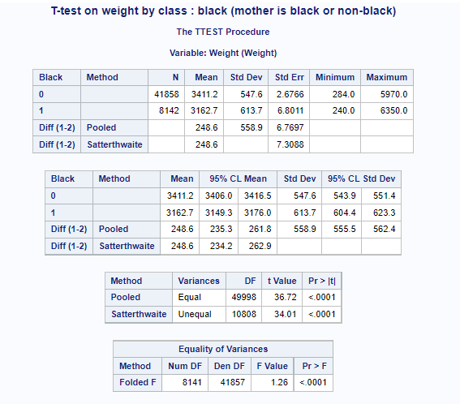
T-TEST RESULTS
title 'T-test on weight by class : black (mother is black or non-black)';
proc ttest data=work.birth;
class Black;
var Weight;
run;

Slide 4
Interpretation
In the 4th table of T-test results, the P value for F test is <.0001. This means that the P value is <0.05, So Null hypothesis will be rejected, implying that the variances are unequal.
In the 3rd table of T-test results, we check null hypothesis of unequal means with assumption of unequal variances. Here, we find that the t-statistic for unequal variances is 34.01 with a degree of freedom 10808, along with P-value<.0001, inferring that it is not significant.
As P-value<0.05, Null hypothesis (H₀) is rejected and there is much evidence in support of Alternative Hypothesis(H_{a}).

Slide 5
Conclusion
As Null hypothesis (H₀) is rejected from our interpretation, the conclusion is in support of Alternative Hypothesis(H_{a}).
Hence, it can be deduced that average weight of babies of black mother is not equal to average weight of babies of non-black mother.
We also find that the average weight of babies of black mother is less than average weight of babies of non-black mother.

Slide 6
HYPOTHESIS 2
Compare average weight of babies of married mother and unmarried mother.
Null Hypothesis(H₀): | Average weight of babies of married mother is equal to average weight of babies of unmarried mother.
Alternative Hypothesis(H_{a}): | Average weight of babies of married mother is not equal to average weight of babies of unmarried mother.

Slide 7
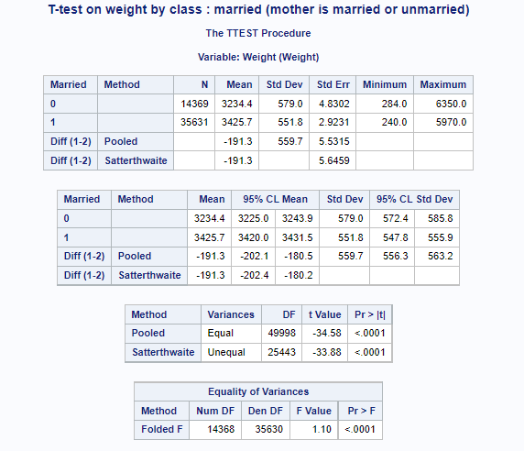
T-TEST RESULTS
title 'T-test on weight by class : married (mother is married or unmarried)';
proc ttest data=work.birth;
class Married;
var Weight;
run;

Slide 8
Interpretation
In the 4th table of T-test results, the P value for F test is <.0001. This means that the P value is <0.05, So Null hypothesis will be rejected, implying that the variances are unequal.
In the 3rd table of T-test results, we check null hypothesis of unequal means with assumption of unequal variances. Here, we find that the t-statistic for unequal variances is -33.88 with a degree of freedom 25443, along with P-value<.0001, inferring that it is not significant.
As P-value<0.05, Null hypothesis (H₀) is rejected and there is much evidence in support of Alternative Hypothesis(H_{a}).

Slide 9
Conclusion
As Null hypothesis (H₀) is rejected from our interpretation, the conclusion is in support of Alternative Hypothesis(H_{a}).
Hence, it can be deduced that average weight of babies of married mother is not equal to average weight of babies of unmarried mother.
We also find that average weight of babies of married mother is greater than that of unmarried mother.

Slide 10
HYPOTHESIS 3
Compare average weight of baby boys with baby girls.
Null Hypothesis(H₀): | Average weight of baby boys is equal to average weight of baby girls.
Alternative Hypothesis(H_{a}): | Average weight of baby boys is not equal to average weight of baby girls.

Slide 11
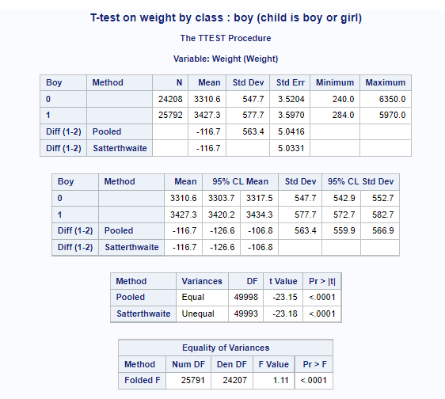
T-TEST RESULTS
title 'T-test on weight by class : boy (child is boy or girl)';
proc ttest data=work.birth;
class Boy;
var Weight;
run;

Slide 12
Interpretation
In the 4th table of T-test results, the P value for F test is <.0001. This means that the P value is <0.05, So Null hypothesis will be rejected, implying that the variances are unequal.
In the 3rd table of T-test results, we check null hypothesis of unequal means with assumption of unequal variances. Here, we find that the t-statistic for unequal variances is -23.18 with a degree of freedom 49993, along with P-value<.0001, inferring that it is not significant.
As P-value<0.05, Null hypothesis (H₀) is rejected and there is much evidence in support of Alternative Hypothesis(H_{a}).

Slide 13
Conclusion
As Null hypothesis (H₀) is rejected from our interpretation, the conclusion is in support of Alternative Hypothesis(H_{a}).
Hence, it can be deduced that average weight of baby boys is not equal to average weight of baby girls.
We also find that average weight of baby boys is greater than average weight of baby girls.

Slide 14
HYPOTHESIS 4
Compare average weight of babies of smoking mother and non-smoking mother.
Null Hypothesis(H₀): | Average weight of babies of smoking mother is equal to average weight of babies of non-smoking mother.
Alternative Hypothesis(H_{a}): | Average weight of babies of smoking mother is not equal to average weight of babies of non-smoking mother.

Slide 15
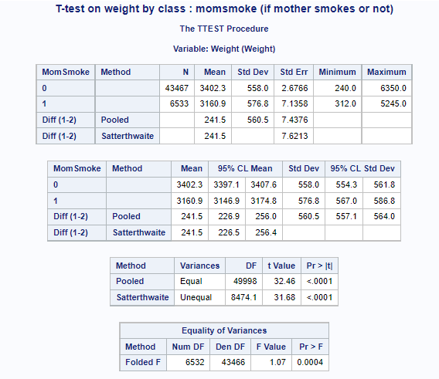
T-TEST RESULTS
title 'T-test on weight by class : momsmoke (if mother smokes or not)';
proc ttest data=work.birth;
class MomSmoke;
var Weight;
run;

Slide 16
Interpretation
In the 4th table of T-test results, the P value for F test is <.0001. This means that the P value is <0.05, So Null hypothesis will be rejected, implying that the variances are unequal.
In the 3rd table of T-test results, we check null hypothesis of unequal means with assumption of unequal variances. Here, we find that the t-statistic for unequal variances is 31.68 with a degree of freedom 8474.1 , along with P-value<.0001, inferring that it is not significant.
As P-value<0.05, Null hypothesis (H₀) is rejected and there is much evidence in support of Alternative Hypothesis(H_{a}).

Slide 17
Conclusion
As Null hypothesis (H₀) is rejected from our interpretation, the conclusion is in support of Alternative Hypothesis(H_{a}).
Hence, it can be deduced that average weight of babies of smoking mother is not equal to average weight of babies of non-smoking mother.
We also find that average weight of babies of mother who smokes is less than that of babies of mother who don’t smoke.

Slide 18
THANK YOU

